Slide 1

Dungeness Juvenile Crab Long Term – CO2 Exposure Study
Dungeness Juvenile
CO2 Exposure Study
2018-2019
2018-2019
Salmon Shed ”Environmental Data”
Presented (2021.04.01)

Slide 2
Outline of Juvenile Crab Study
First date of introduction to Chambers 08AUG18
Last date in Chambers 27AUG18
First Observation (Crab Survival Data) 20AUG18
First Day of Salmon Shed Monitoring 23AUG18
Last Observation (Crab Survival Data) 10JUL19

Slide 3
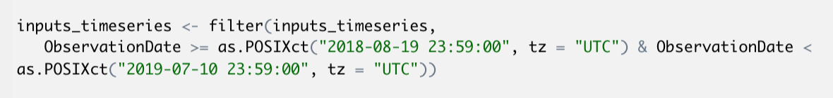
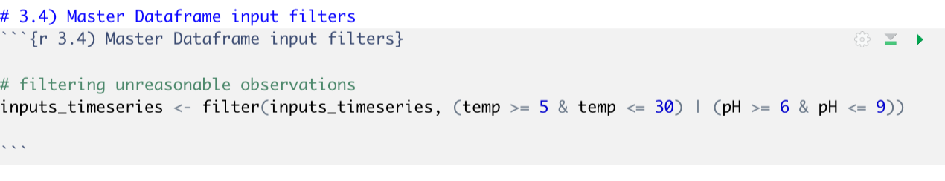
Outline of Filters Placed on dataframe
Filtering on Dates
Filtering on temperature

Slide 4
I need help- is there a way to filter and facet?

Slide 5
Let’s look at Tables

Slide 6
Temperature
ObservationMonth | UDA2182: mean | 20449374: mean | OrionStarA112: mean | UDA2182: sd | 20449374: sd | OrionStarA112: sd | UDA2182: se | 20449374: se | OrionStarA112: se
2018-08-August | 12.52 | NA | NA | 0.11050125 | NA | NA | 0.02470883 | NA | NA
2018-09-September | 13.0143434 | NA | NA | 1.81626448 | NA | NA | 0.18254145 | NA | NA
2018-10-October | 12.3550388 | NA | NA | 0.21174913 | NA | NA | 0.01864347 | NA | NA
2018-11-November | 11.5326923 | 11.3793916 | NA | 0.36134654 | 0.1196862 | NA | 0.03543294 | 0.00472732 | NA
2018-12-December | 10.3089286 | 10.3477688 | NA | 0.49110164 | 0.39654733 | NA | 0.04640474 | 0.00593517 | NA
2019-01-January | 9.2325 | 9.30118504 | NA | 0.17108772 | 0.15499672 | NA | 0.0156181 | 0.00231985 | NA
2019-02-February | 8.55 | 8.63489583 | NA | 0.33245498 | 0.30764539 | NA | 0.03393104 | 0.00484496 | NA
2019-03-March | 8.47155172 | 8.65231318 | NA | 0.32135746 | 0.25891023 | NA | 0.02983729 | 0.00437264 | NA
2019-04-April | 9.21057692 | 9.46817754 | NA | 0.31925832 | 0.24384878 | NA | 0.03130585 | 0.00383978 | NA
2019-05-May | 10.4241667 | 10.6796602 | NA | 0.64560516 | 0.38424253 | NA | 0.05893542 | 0.00646631 | NA
2019-06-June | 11.23125 | 10.9003156 | 11.9295455 | 0.38015855 | 0.24682229 | 0.24925894 | 0.03879977 | 0.01096176 | 0.02314311
2019-07-July | 11.9625 | NA | 12.2088235 | 0.34054037 | NA | 0.33154153 | 0.0601996 | NA | 0.04177031

Slide 7
Salinity
ObservationMonth | OrionStarA112: mean | SENSOREXtorodial: mean | OrionStarA112: sd | SENSOREXtorodial: sd | OrionStarA112: se | SENSOREXtorodial: se
2018-08-August | 29.0071429 | NA | 0.88331046 | NA | 0.23607465 | NA
2018-09-September | 30.2766667 | NA | 0.02425356 | NA | 0.00571662 | NA
2018-10-October | 29.11 | NA | 1.20479044 | NA | 0.20079841 | NA
2018-11-November | 30.3975 | 29.9590909 | 0.42978718 | 0.34555621 | 0.06203444 | 0.10418912
2018-12-December | 30.4166667 | 29.9954167 | 0.10485364 | 0.20662882 | 0.01747561 | 0.04217793
2019-01-January | NA | 29.33 | NA | 0.32921013 | NA | 0.06010527
2019-02-February | 29.3775 | 29.3041667 | 0.65142887 | 0.25104853 | 0.09402566 | 0.05124507
2019-03-March | 29.5 | 29.537931 | 0 | 0.09788402 | 0 | 0.01817661
2019-04-April | 29.3765957 | 29.4692308 | 0.15066918 | 0.21497764 | 0.02197736 | 0.04216058
2019-05-May | 29.6256604 | 29.4444444 | 0.17690186 | 0.11208971 | 0.02429934 | 0.02157167
2019-06-June | 29.6830556 | 29.6925 | 0.30070171 | 0.3170146 | 0.02791945 | 0.04779175
2019-07-July | 29.9082759 | 30.0068182 | 0.25263001 | 0.26821076 | 0.03182839 | 0.05718273

Slide 8
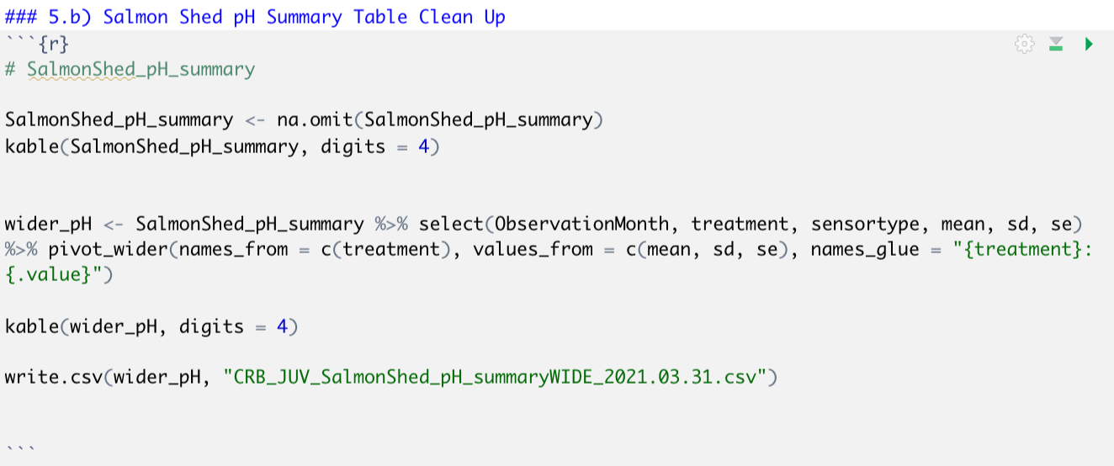
pH – how to I include Treatment….
ObservationMonth | sensortype | ambient: mean | highCO2: mean | ambient: sd | highCO2: sd | ambient: se | highCO2: se
2018-08-August | OceanOptics1.6.7 | 7.68251991 | 7.23263379 | 0.03987104 | 0.03566063 | 0.02301956 | 0.02058867
2018-08-August | UDA2182durfet | 7.64875 | 7.20666667 | 0.17024667 | 0.01073087 | 0.06019129 | 0.00309773
2018-09-September | OceanOptics1.6.7 | 7.65323528 | 7.14414359 | 0.08160614 | 0.09142571 | 0.02720205 | 0.03047524
2018-09-September | UDA2182durfet | 7.72078947 | 7.21186441 | 0.04681081 | 0.02885604 | 0.00759372 | 0.00375674
2018-10-October | OceanOptics1.6.7 | 7.69831667 | 7.16394859 | 0.02096428 | 0.06353042 | 0.00494133 | 0.01497426
2018-10-October | UDA2182durfet | 7.73816327 | 7.20790123 | 0.08235273 | 0.04831449 | 0.01176468 | 0.00536828
2018-11-November | OceanOptics1.6.7 | 7.52573154 | 7.17032087 | 0.35027577 | 0.09318693 | 0.07149974 | 0.0190217
2018-11-November | UDA2182durfet | 7.8062963 | 7.2175641 | 0.13817904 | 0.06997562 | 0.02659257 | 0.00792318
2018-12-December | OceanOptics1.6.7 | 7.66196587 | 7.22431934 | 0.19613125 | 0.15438425 | 0.04622858 | 0.03638872
2018-12-December | UDA2182durfet | 7.79103448 | 7.20083333 | 0.10199247 | 0.0385961 | 0.01893953 | 0.00421118
2019-01-January | UDA2182durfet | 7.80333333 | 7.19333333 | 0.01295439 | 0.03256799 | 0.00236514 | 0.00343297
2019-02-February | OceanOptics1.6.7 | 7.75430338 | 7.18347327 | 0.01843764 | 0.07773227 | 0.00376357 | 0.01586703
2019-02-February | UDA2182durfet | 7.8225 | 7.22541667 | 0.01188715 | 0.11865369 | 0.00242645 | 0.01398347
2019-03-March | OceanOptics1.6.7 | 7.78264051 | 7.12637028 | 0.03876659 | 0.11227477 | 0.00913737 | 0.02646342
2019-03-March | UDA2182durfet | 7.8637931 | 7.17896552 | 0.06789771 | 0.06034849 | 0.01260829 | 0.00647004
2019-04-April | OceanOptics1.6.7 | 7.79019127 | 7.14482452 | 0.0530376 | 0.07206121 | 0.0110591 | 0.01470943
2019-04-April | UDA2182durfet | 7.98615385 | 7.19487179 | 0.17366812 | 0.06948313 | 0.03405912 | 0.00786742
2019-05-May | OceanOptics1.6.7 | 7.81207467 | 7.15372482 | 0.05496659 | 0.10436074 | 0.01057833 | 0.02046682
2019-05-May | UDA2182durfet | 8.02666667 | 7.18588889 | 0.15104997 | 0.09006732 | 0.02757782 | 0.00949393
2019-06-June | OceanOptics1.6.7 | 7.84742646 | 7.23000877 | 0.01838739 | 0.16907408 | 0.0044596 | 0.03878825
2019-06-June | UDA2182durfet | 8.00375 | 7.20208333 | 0.17226906 | 0.06493632 | 0.03516428 | 0.00765282
2019-07-July | OceanOptics1.6.7 | 7.80632737 | 7.20361234 | 0.01128752 | 0.1593872 | 0.00460811 | 0.07128012
2019-07-July | UDA2182durfet | 7.91625 | 7.22083333 | 0.20556108 | 0.17844538 | 0.07267682 | 0.03642501

Slide 9
Salinity (Orion Conductivity Probe)

Slide 10
Salinity (Wall Mounted UDA Display)

Slide 11
Salinity (Salmon Shed Alone)

Slide 12
Salinity (All Conductivity Records)

Slide 13
Salinity (All Conductivity Records)
Restrict Dates Further to ~20AUG2018
Further investigate Chase’s SPEC salinity recorded values
Ask Lindsay/Eileen for records
Wells Pt Orca Buoy – are they correlated?
NANOOS UW Edu Data for Download
Daily Unit?
correlate
There back again create salinity timeseries

Slide 14
Conductivity Sensor Problem: conductivity gaps without corresponding temperature gaps

Slide 15
Water Chemistry- pH (UDA and SPEC)

Slide 16
Water Chemistry- pH by Probe, by Treatment

Slide 17
Water Chemistry- pH by Probe, by Treatment (y axis limitations (6.5, 8.5)
3 different probes – call out to see break out
Change sensor type “OrionStarA112” create 2 sensor types
High CO2 DF where I can pull out tank to tank comparison

Slide 18
Probe’rodeo

Slide 19
UDA data from Salmon Shed

Slide 20
UDA data displayed by Tank/Display No.

Slide 21
Water Temperature (All Inputs)

Slide 22
Water Temperature (Salmon Shed & Chum House)

Slide 23
Water Temperature (Y axis limitation 5, 30)

Slide 24
Water Temperature (Y axis limitation 5, 18)
Look for fluke readings for insitu readings
Look for DIC sample recorded Salinity Samples
First date 28AUG18

Slide 25
Dissolved Oxygen (Assumed Constant of 29.5)
Okay how am I getting 10 columns? And 1 with 13?

Slide 27
Kate’s Questions
The Conductivity Probe in the Salmon Shed
Is this a Tordial? Something?
What other aspects are we looking to learn- seasonal averages?
ECDF plots- probably for the High CO2
Make fewer dataframes
Change sensor type “OrionStarA112” create 2 sensor types
Further investigate Chase’s SPEC salinity recorded values
Ask Lindsay/Eileen for records
3 different probes – call out to see break out
High CO2 DF where I can pull out tank to tank comparison
Wells Pt Orca Buoy – are they correlated?
NANOOS UW Edu Data for Download
Look for DIC sample recorded Salinity Samples

Slide 28
Follow On
Ambient Means, Standard Error, Standard Deviation (to explain the seasonal variation)
Monthly Tables for all! Salinity | pH | Temperature
Descriptive Stats Table
Be able to add a monthly alkalinity value to the table
Conditions of the chambers- find the chamber data (Temp | pH (SPEC))
Find chamber SPEC values and use salinity values to close gap (august time)

Slide 29
Lesson Learned About Salinity
Where and When will we sample insitu readings
HST
Head Tank
Bottles? … have to for SPEC

